Slide 1
The Nerd Value of Solar Power
Why we added solar, how it works, how much it cost, and how much we make from it.
Andrew Leach, Alberta School of Business

Slide 2
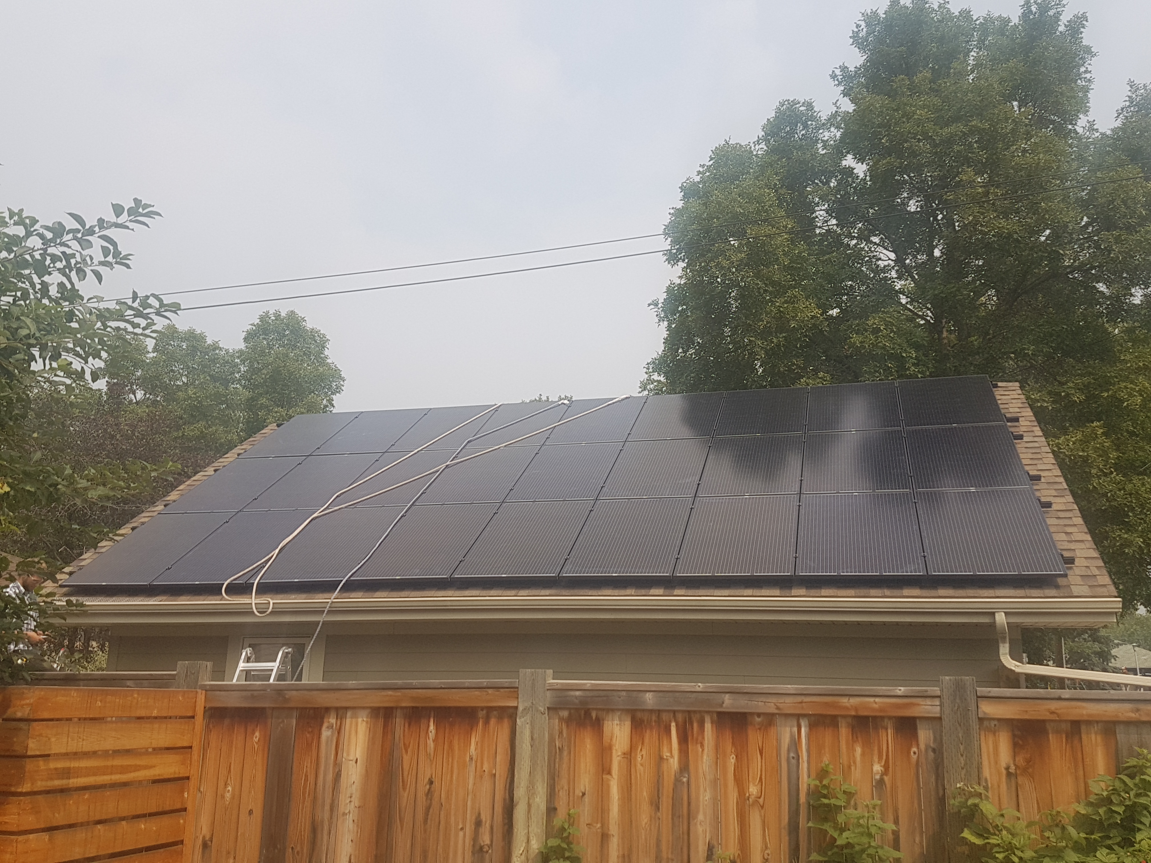
Our solar power system
Grid-connected, 27 panel system
7.6 kW installed capacity (DC)
South-facing, with some tree-shading
36º roof angle purpose-built for solar
Two monitoring systems Neurio for consumption and generation A/P systems for panel-level performance

Slide 3
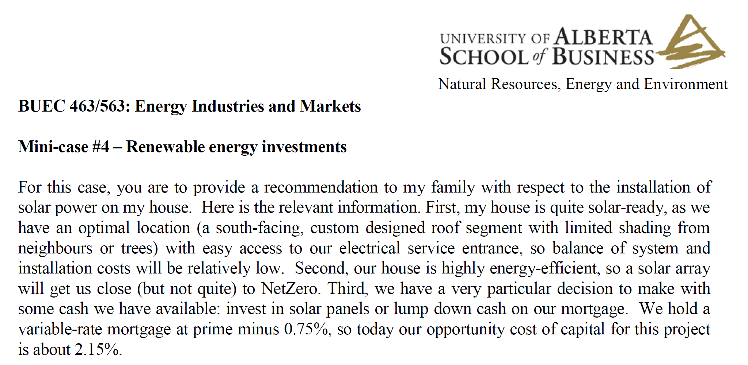
Why we added solar power

Slide 4
Why we added solar power
I gave my students an assignment each year on installing solar using my own house and family as the 'clients'
I got updated quotes each year (Thanks, Kyle Kasawski!)
Each year, students would reliably find that it didn't make financial sense
In 2017, one group explained that, if a solar power system would generate a cup of coffee per day of nerd value, it would have a 20% rate of return
They knew me well enough that…

Slide 5
…we ended up with a solar power system
Total system cost (installed) was $18,900 or $2.50 per watt
Rebate from Energy Efficiency Alberta covered 30%, or $5670
Our total cost (installed) was $13,230, or $1.62 per watt
Whether it would be worth it would depend on power prices and nerd value

Slide 6
How much does our system generate

Slide 7
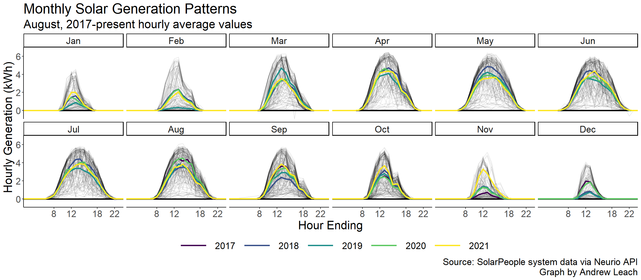
How much does our system generate

Slide 8
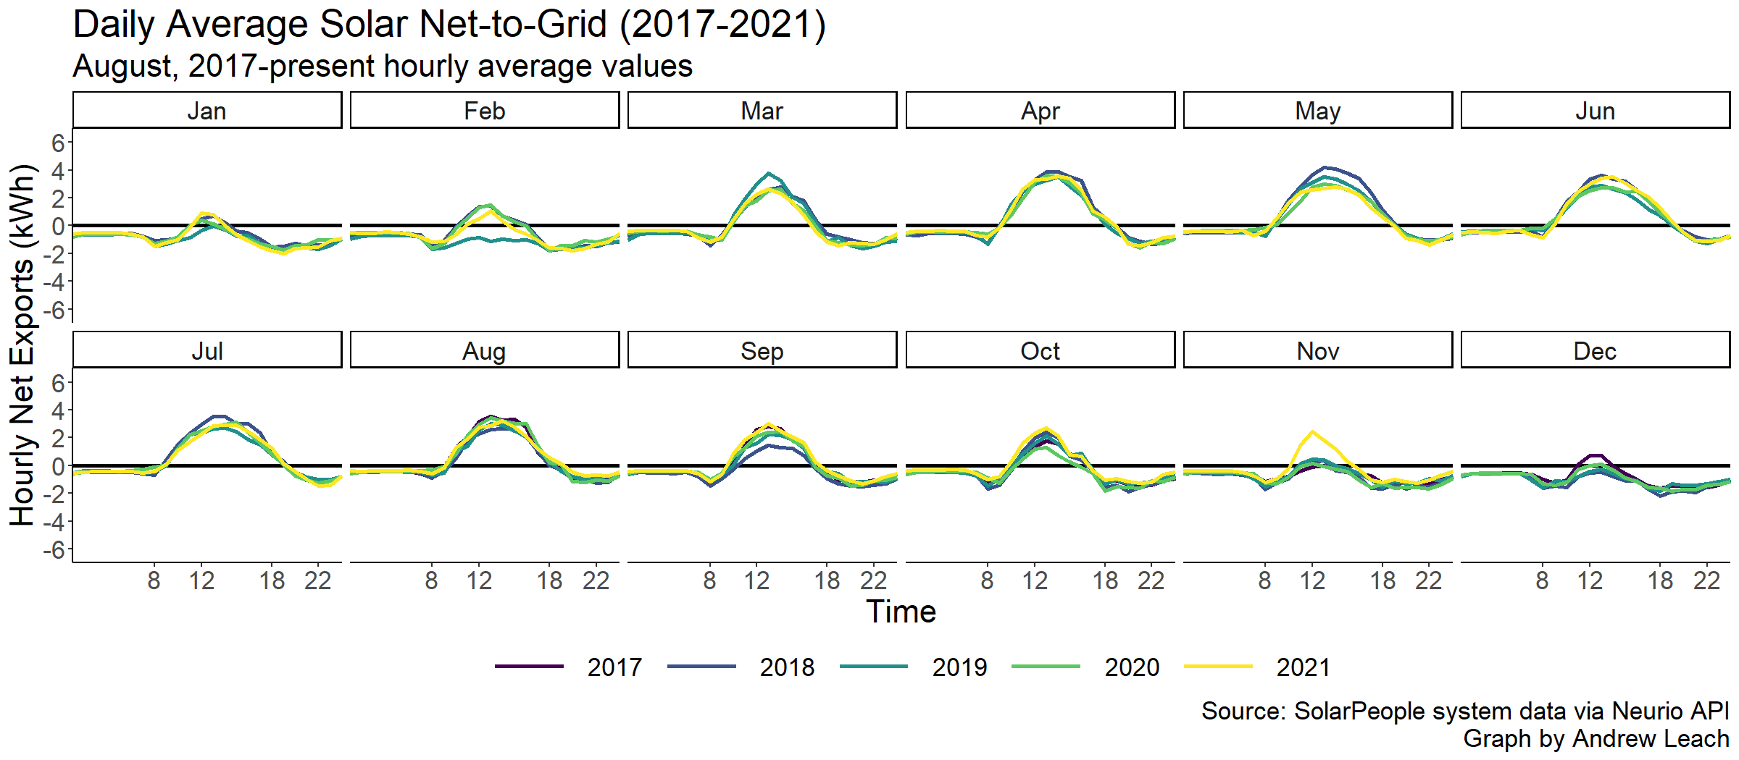
Net sales – negative numbers are consumption

Slide 9
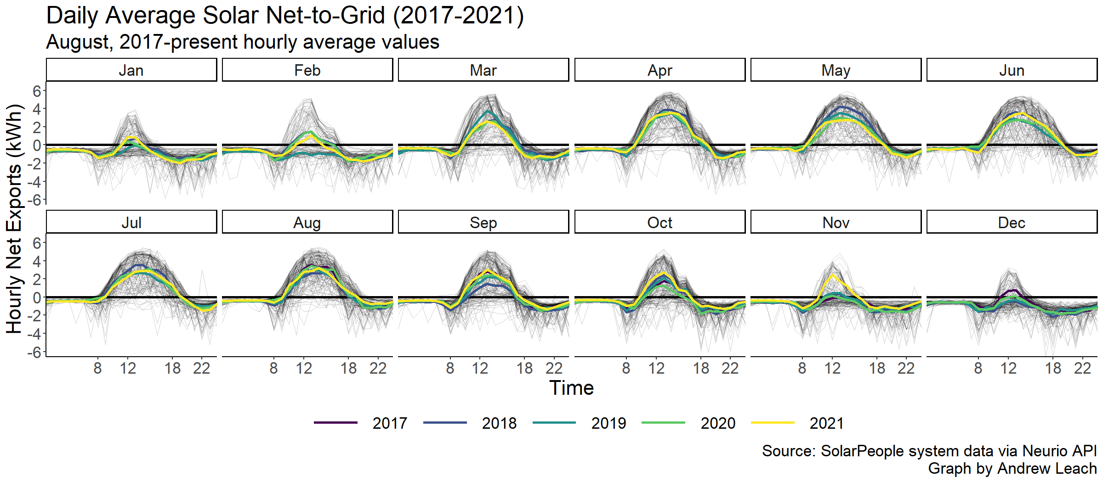
Net sales – negative numbers are consumption

Slide 10
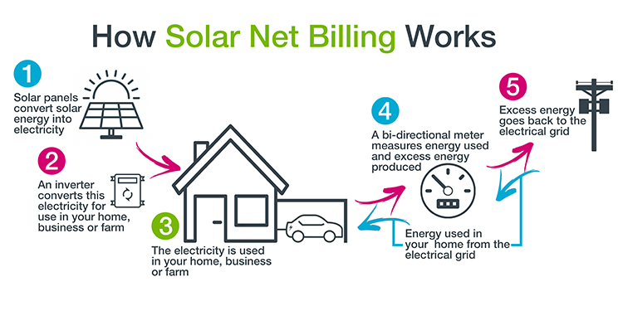
How does it show up on my bill?
Diagram: Utilities Consumer Advocate

Slide 11
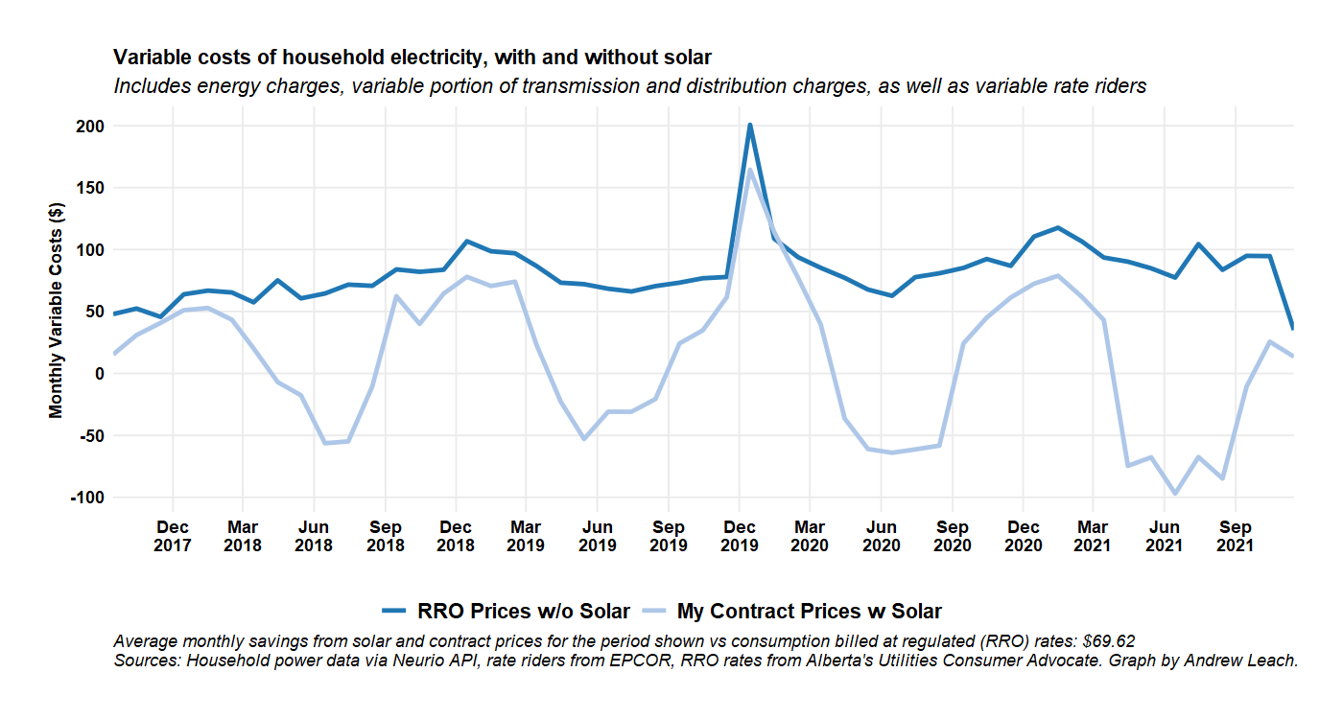
Does it save money? Enough to cover the cost of installation?

Slide 12
Does it save money? Enough to cover the cost of installation?
Yes! Since we can generally sell back at a higher price in the summer, we’ve been making money each year.
Current savings are about $1000 per year
At present, our expected financial rate of return is about 4%
But what about nerd value?

Slide 13
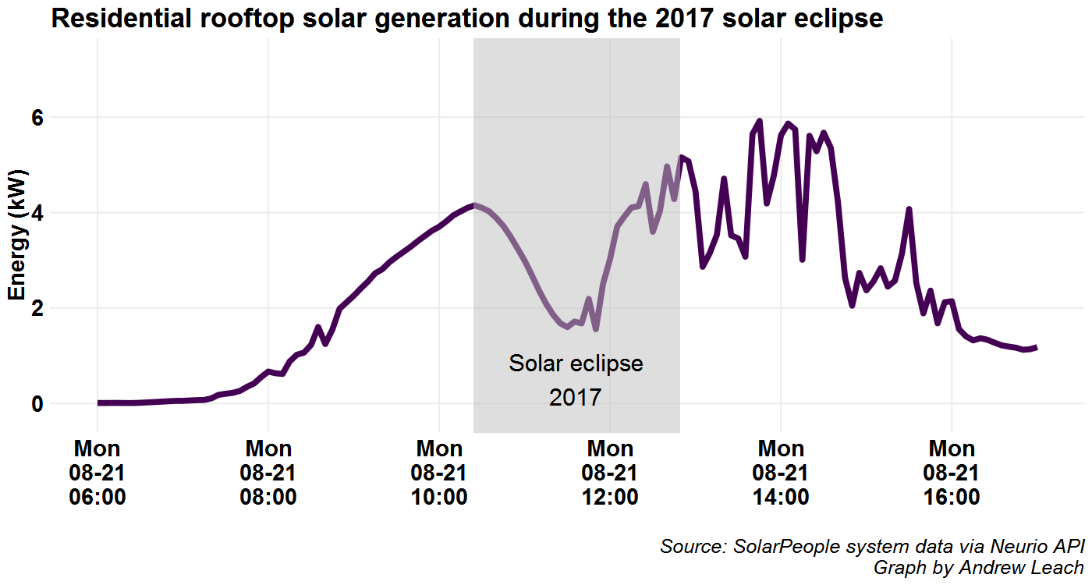
What do you mean by nerd value?

Slide 14
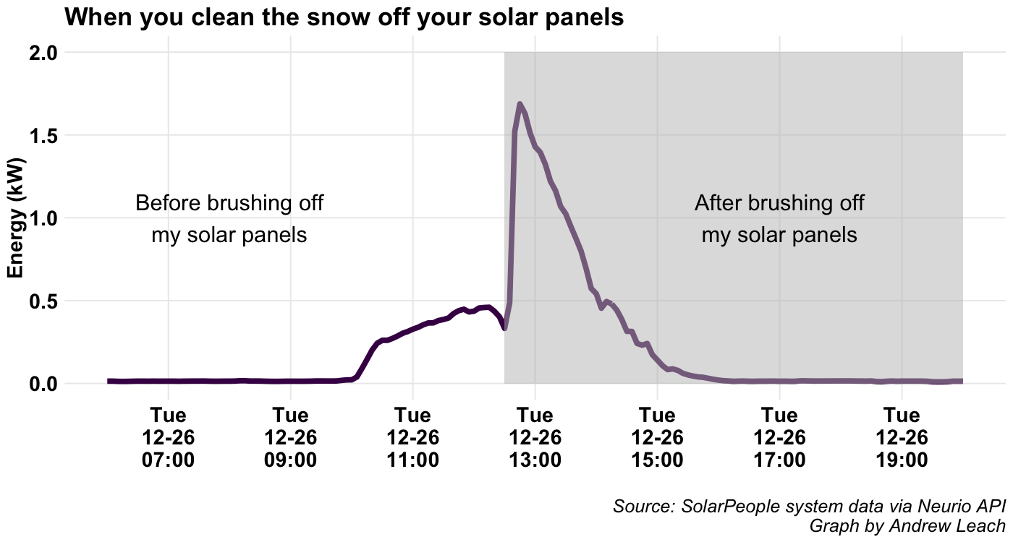
What do you mean by nerd value?

Slide 15
Does it save money? Enough to cover the cost of installation?
Yes! Since we can generally sell back at a higher price in the summer, we’ve been making money each year.
Current savings are about $1000 per year
At present, our expected financial rate of return is about 4%
If current monthly returns remain consistent, and I add a cup-of-coffee-per-day of nerd value would push the return to 19%
I guess my students did a pretty good job!

Slide 16
Conclusions
Energy systems are all around us, including in our houses and apartments
Technology has meant that what used to be a one-way relationship has been upended by prosumers
Understanding the system as a whole, as well as how you fit into it, positions you for better decisions as a prosumer

